Slide 1
Local Linear Regression in Reinforcement Learning
Project title: Speeding up Reinforcement Learning using model-building techniques and Prioritized Sweeping
Thijs Ramakers
Supervisors:
prof. dr. R. Babuška, dr. G. Lopes, E. Schuitema M.Sc
MSc Workshop, January 29, 2010
Delft Center for Systems and Control
Notes:
Hello everybody, thanks for being present here.
Introduction to by Msc thesis, titled ‘speeding up reinforcement learning using prioritized sweeping and model-building techniques’

Slide 2
Overview
Solving a reinforcement learning problem:
Model-learning approach
Local Linear Regression
Humanoid robot results
Summary / Future work
January 29, 2010

Slide 3
Solving a Reinforcement Learning problem
Solution: Find value function for the entire state-space
Method: By using a model or by interaction with real setup
Problem: State-space is usually very large, due to:
  Many discrete states
  Many dimensions
  Continuous state-variables
January 29, 2010
Notes:
RL problems can be solved for relatively simple problems. For larger problems, learning becomes slow due to:
Continuous states. VF has to be approximated and a state is never encountered twice.
High number of dimensions: leads to a very high number of states. Makes it very difficult to determine VF for the total state-space
Slow propagation of information: Once the goal is found, this information propagates through the state-space very slowly.
This last problem is dealt with in the work.

Slide 4

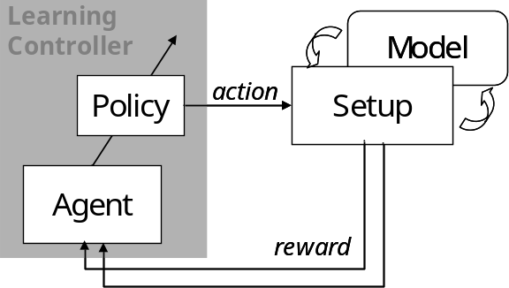
Model-learning approach
No model available, but interaction with setup only is not sufficient
Build a state-transition model:
Use model to re-live experiences
More experiences to fill state-space
Use model and setup simultaneously
state
January 29, 2010
Notes:
Several solution approaches exist. We will focus on the model-learning approach.
Model-learning:
No a priori model is available, but model is learned during the learning process.
Solution method: Switching between on-line (model-free) and off-line (model-based) learning.
The model is used to generate more experiences to learn from. The same update rule is used for the model and the setup. Fill total sample interval with model-based experiences.

Slide 5



Model-building demands
Local Linear Regression:
  Dealing with continuous state variables
  Model non-linear system
  Estimate model from few observations
  Accurate enough to be used with learning
  Applicable to high dimensional problems
  Efficient in CPU & memory usage
January 29, 2010
Notes:
Demands for the model-building technique:
Continuous states
Learning from few observations
Good accuracy (only in parts of state space?)
High dimensional problems
Efficient in CPU/memory usage (has to be applied in real time)

Slide 6
Memory-based modeling
Store all past experiences in memory
Advantages:
+ Fast learning (new experiences are used immediately)
+ Adapt to changes
    + No fixed (global) structure needed
    + Statistical analysis possible
Disadvantages:
    - Storing large dataset
    - Noise sensitive
January 29, 2010
Notes:
Focus on a type of model-building technique called memory-based. A large number of experiences is simply stored in memory and used when needed.
Advantages:
Function can be approximated locally
No global structure is needed
Disadvantages:
Large dataset has to be stored.
Noise sensitive

Slide 7

Local Linear Regression (LLR)
        Store observed experiences
        (state, action → next state)
        Search K nearest samples
        (according to some distance measure)
        Estimate linear model:
        (using Least Squares techniques)
        Results in a piece-wise linear model
y
ŷ
(K = 5)
X_{q}
x
January 29, 2010
Notes:
The K-Nearest Neighbor method also relies on storing past input-output pairs.
The estimated output is simply obtained by averaging the output of the K nearest stored inputs. Calculating the distances of all samples is the most computationally heavy.
K can be seen as a measure for the amount of generelization.
Local Linear Regression can be seen as an extension to KNN. Instead of averaging the outputs, a linear model is fitted to the K data samples. This leads to a piece-wise linear model.
A simple Least Squares approach can be used. Weighted Least Squares is also possible to give a higher weight to close samples.

Slide 8
Number of neighbors
Tuning parameter: number of neighbors K
Optimal value depends (locally) on:
  Number of samples in memory
  Sample density
  Linearity of target function
  Noise
Optimal value can vary throughout the state-space
January 29, 2010

Slide 9
Optimal number of neighbors
Influence of K on estimation error in three different situations
Linear function with noise
Nonlinear function without noise
Nonlinear function with noise
y
y
y
ŷ
ŷ
ŷ
x_{q}
x
x_{q}
x
x_{q}
x
error
error
error
K = ∞
K = 1
K = ?
K
K
K
January 29, 2010

Slide 10
Number of neighbors (1D example)
Dataset
Error (varying K)
Parameters:
1D nonlinear function
Added white noise (σ²=0.01)
100 samples
Query points
  x_{q} = 0, 0.01, 0.02, …, 1
K = 1, 2, …, 40
Optimal value: 3 < K < 10
K
Local Linear Regression estimate (K = 7)
99% confidence interval
January 29, 2010

Slide 11
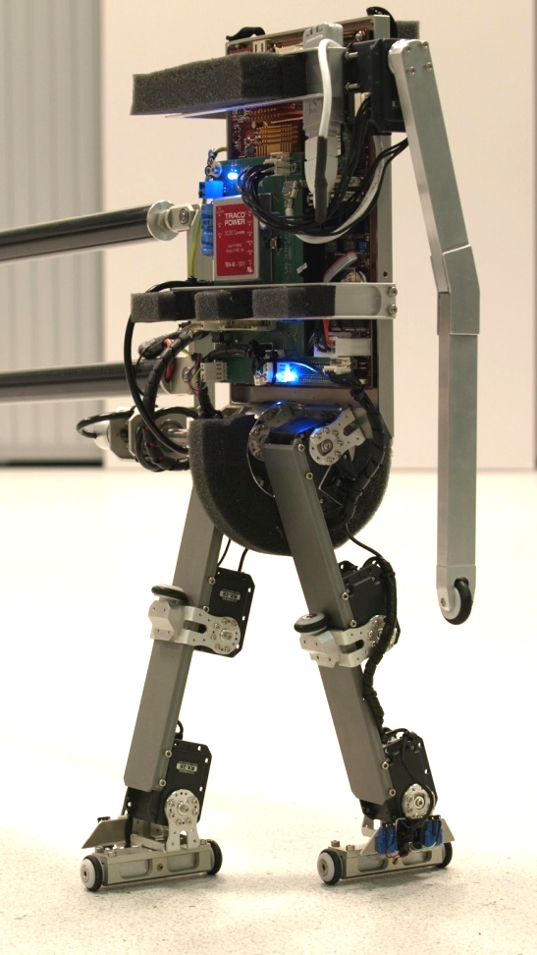
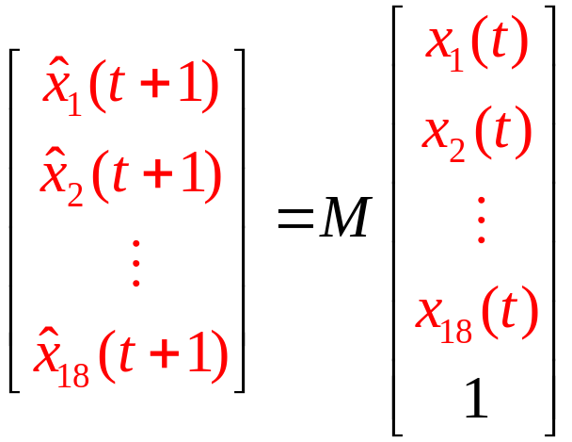
Experiment with humanoid robot
(real setup)
18 state variables
6 inputs (motors)
Dataset: walking motion (PD controller)
Estimated model is affine, not truly linear
January 29, 2010

Slide 12
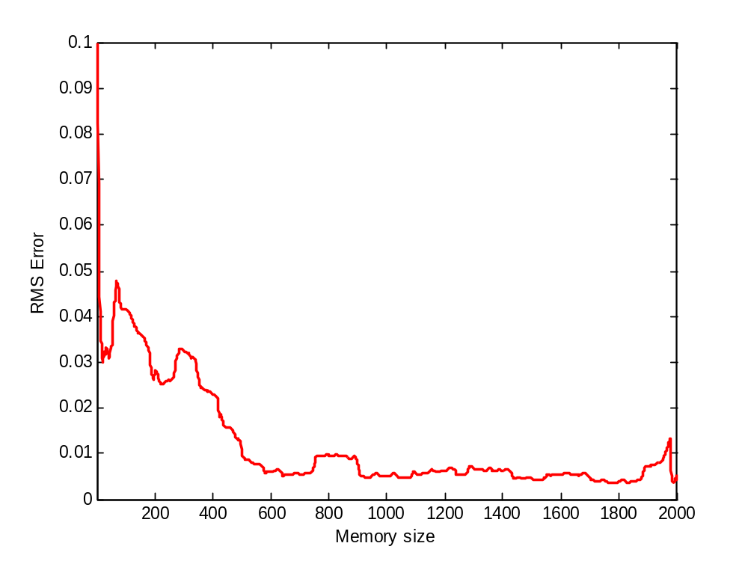
Humanoid robot results
Parameters:
T = 13 s
f_{s} = 150 Hz
Walking motion
(~15 steps)
Increasing memory size
Estimate improves
drastically in 600 samples
(~4 steps)
January 29, 2010

Slide 13
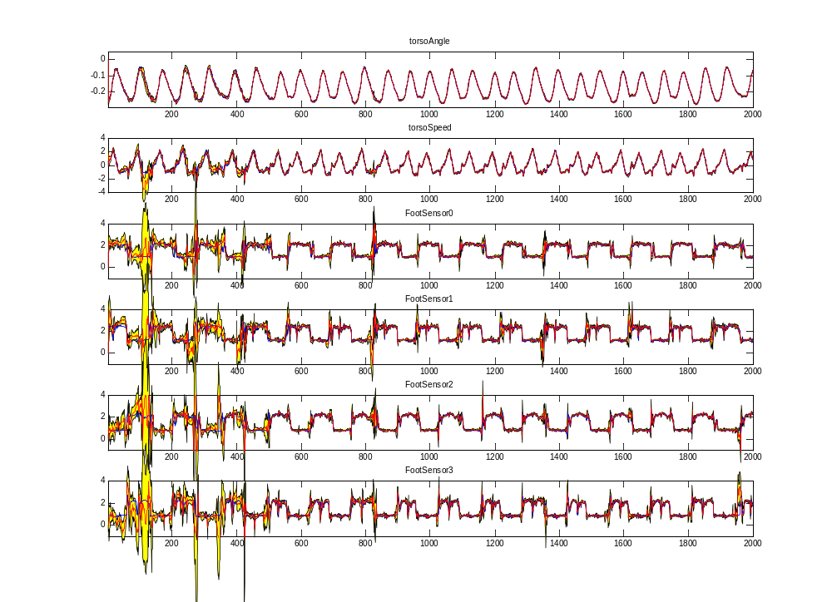
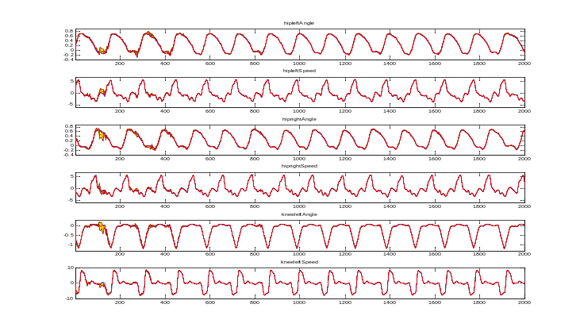
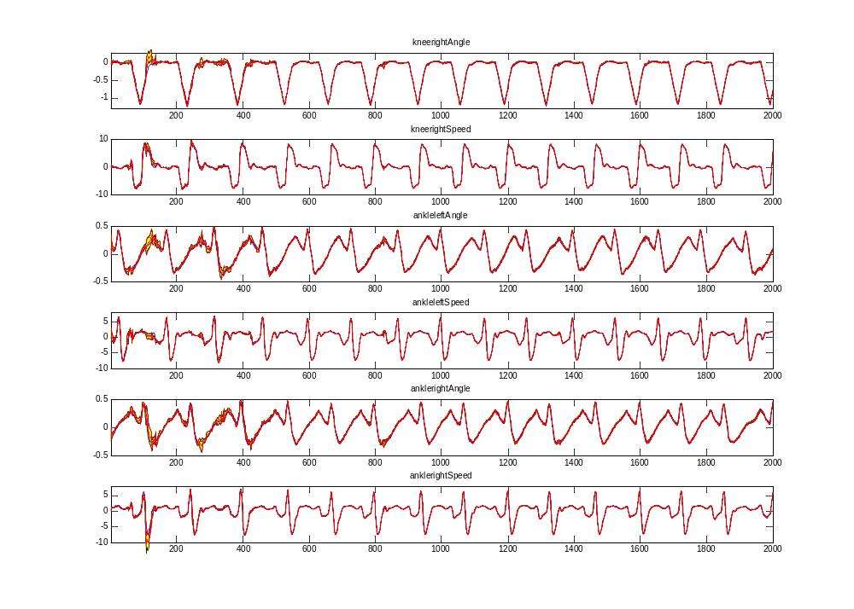
Humanoid robot results
Angle right ankle
Foot contact sensor right
January 29, 2010

Slide 14
Summary
  Memory-based modeling is attractive in a reinforcement learning setting
  LLR is able to model a high-dimensional humanoid robot setup
Future work
  Implement a LLR model in Reinforcement Learning
  Investigate the influence of a model on the learning speed
  Relate the quality of the model to learning speed
January 29, 2010
Notes:
I would like to conclude with an overview of the total project.
I will research two important aspects of PS:
Different techniques for building a state-transition model
Influence of PS on learning speed
Application on increasingly complex setups
Finally: Application of PS on robot Leo (Leo learns to walk?)

Slide 15
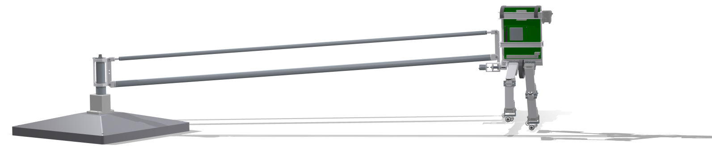
Questions, Comments, Suggestions?
January 29, 2010
Notes:
Are there any questions? Or suggestions?

